Slide 1
Video 10 - Data collection
Steve Simon

Slide 2
Learning objectives
To discuss different methods of collecting data
To discuss when different data collections methods are most appropriate
To describe the advantages and disadvantages of different data collection methods

Slide 3
Required reading
Chapters 13, 15

Slide 4
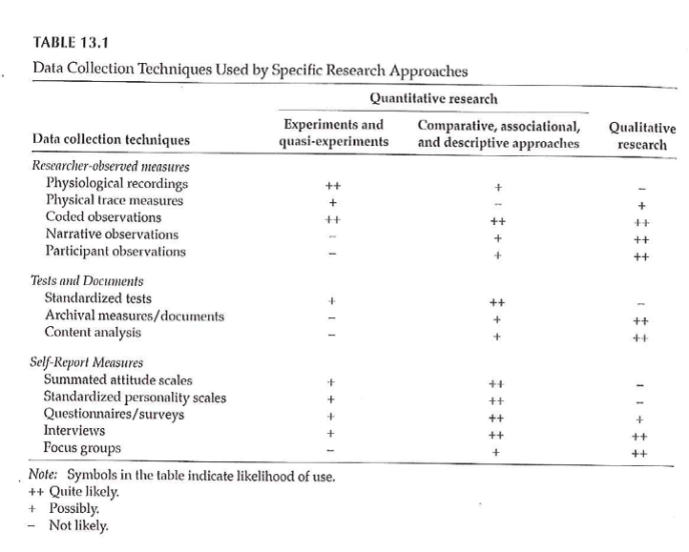
Data Collection Techniques

Slide 5
Data Collection Techniques
Standardized vs Investigator-Developed Instruments
Development and Use
Evidence to support investigator-developed instruments

Slide 6
Data Collection Techniques
Researcher-Observed Measures
Naturalness of the setting
Observer “participation”
Amount of detail
Breadth of coverage

Slide 7
Data Collection Techniques
Tests and Documents
Standardized tests
Norm referenced test
Criterion referenced test
Achievement tests
Performance and Authentic assessments
Aptitude tests
Documents
Content analysis

Slide 8
Data Collection Techniques
Self-Report Measures
Standardized Personality Inventories
Attitudes / Beliefs scales
Likert scale
Semantic differential scale
Questionnaires
How delivered / administered
Item types
Interviews
Focus groups

Slide 9
Descriptive Research
Surveys
Methods
Interview
Questionnaires
Design of surveys
Research question
Review of existing instruments
Process of designing survey

Slide 10
Data Collection Techniques
Surveys
Survey question format –
Open-ended
Close-ended
Wording of questions
Scales
Scale of measurement
Response options

Slide 11
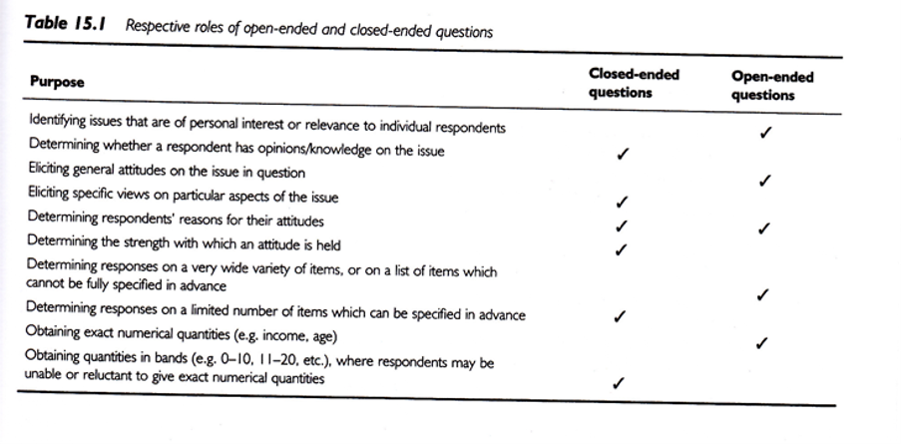
Data Collection Techniques
Notes:
Open-ended vs Close-ended
.footnote[Sim & Wright, 2002]

Slide 12
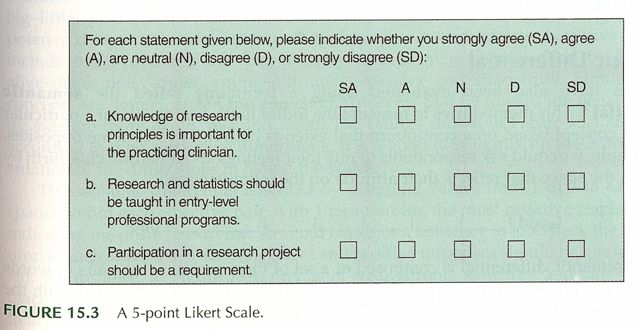
Data Collection Techniques
Notes:
Surveys – Response Options
Likert
.footnote[Portney & Watkins, 2009]

Slide 13
Data Collection Techniques
..
Notes:
Surveys – Response Options
Likert
.footnote[Sim & Wright, 2002]

Slide 14
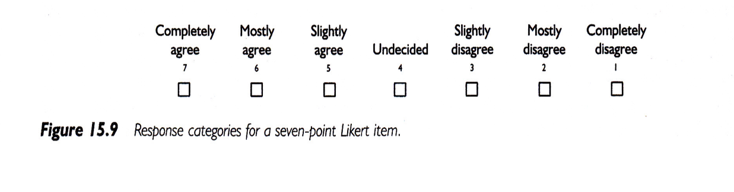
Data Collection Techniques
Notes:
Surveys – Response Options
Likert
.footnote[Sim & Wright, 2002]

Slide 15
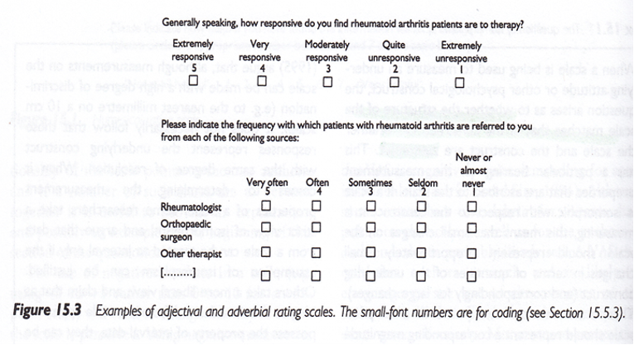
Data Collection Techniques
Notes:
Surveys – Response Options
.footnote[Sim & Wright, 2002]

Slide 16
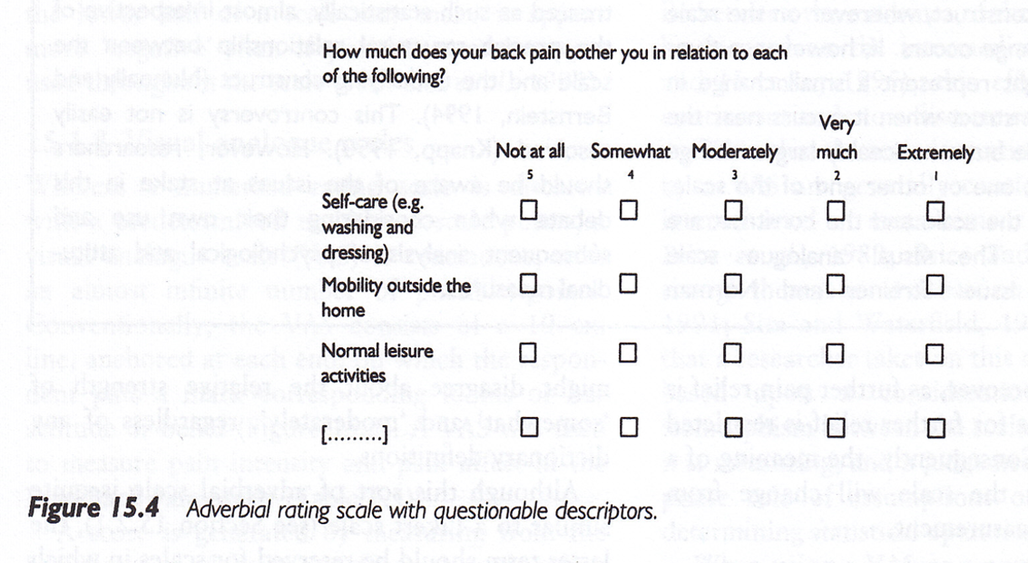
Data Collection Techniques
Notes:
Surveys – Response Options
.footnote[Sim & Wright, 2002]

Slide 17
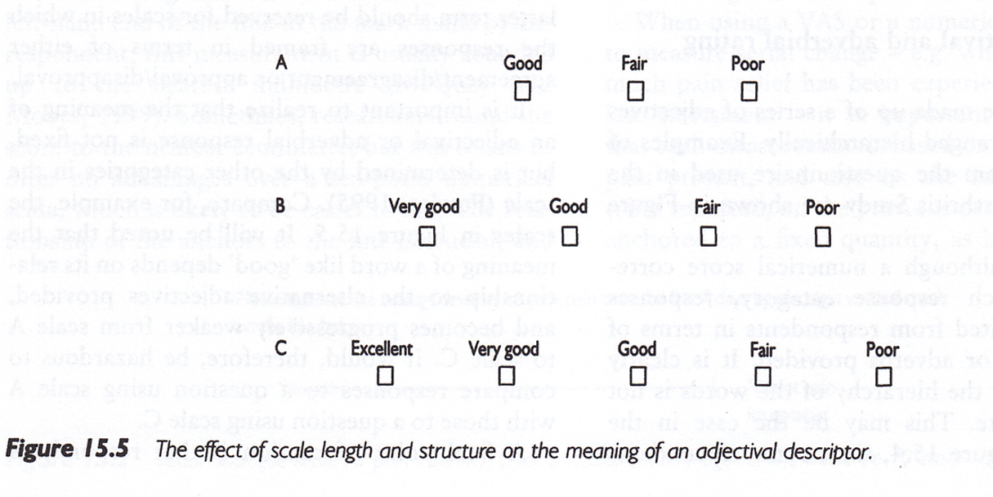
Data Collection Techniques
Notes:
Surveys – Response Options
.footnote[Sim & Wright, 2002]

Slide 18
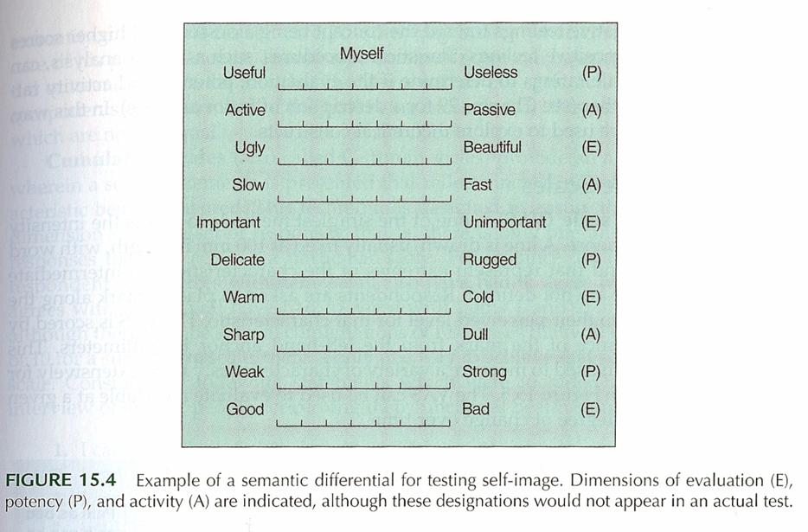
Data Collection Techniques
Notes:
Surveys – Response Options
Semantic Differential
.footnote[Portney & Watkins, 2009]

Slide 19
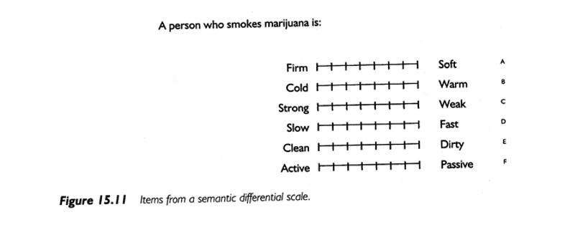
Data Collection Techniques
Notes:
Surveys – Response Options
Semantic Differential
.footnote[Portney & Watkins, 2009]

Slide 20
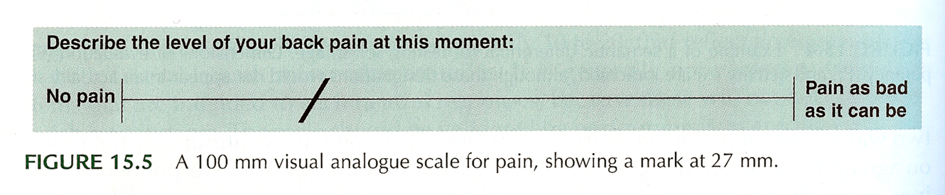
Data Collection Techniques
Notes:
Surveys – Response Options
Visual Analogue Scale (VAS)
.footnote[Portney & Watkins, 2009]

Slide 21
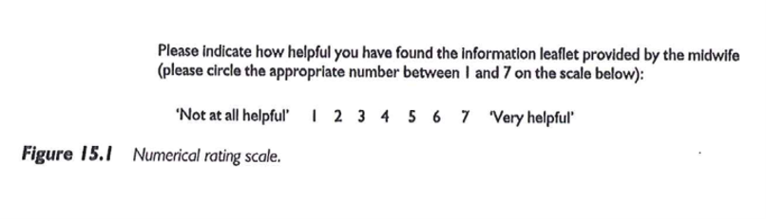
Data Collection Techniques
Notes:
Surveys – Response Options
Numerical Rating Scale
.footnote[Sim & Wright, 2002]

Slide 22
Descriptive Research
Surveys
Pit-falls and words of caution
How responses are recorded
Wording of items
Literacy level
“ Loaded ” wording
Complexity of items
More than 1 “ unit ” in a single item
Clearly stated terms

Slide 23
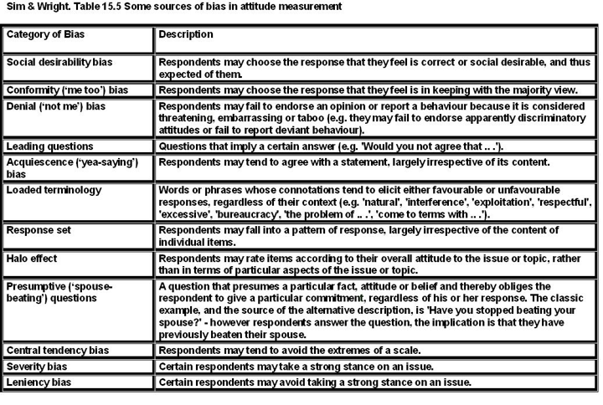
Data Collection Techniques
Notes:
Surveys

Slide 24
Data Collection Techniques
Surveys – Example
Using a scale of 0 to 100, please indicate the percentage of time you take all the doses of your medicine?
… take all the pills in each of your doses?
… take all doses on the prescribed schedule?
… follow all special instructions …
… make sure you refill all of your medications on time?

Slide 25
Data Collection Techniques
Process of developing a survey
List of measures/variables
What ’ s already available?
Put the pieces together
Test and revise as needed
Final check – do you really need all of the items?
Analysis of survey data

Slide 26
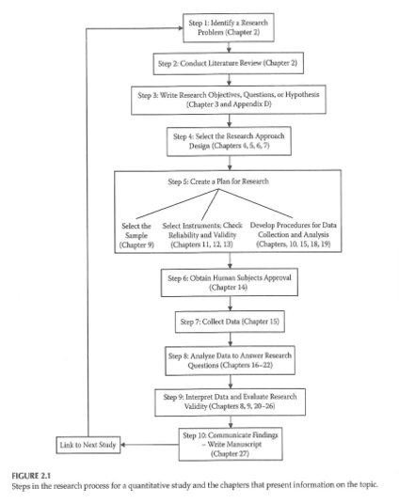
Data Collection & Coding

Slide 27
Data Collection & Coding
Initial Steps
Planning the study
Pilot testing
Data collection
Check for completeness if possible

Slide 28
Data Collection & Coding
Data Coding, Entry, and Checking
Guidelines
Mutually exclusive levels
Code for maximum information
Record is as complete as possible
Consistency
Data entry form
Checking entry

Slide 29
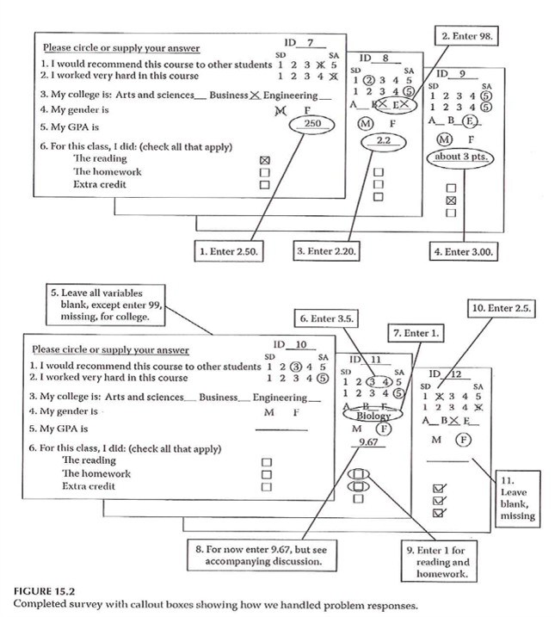
Data Collection & Coding

Slide 30
Data Collection & Coding
Data Entry into Statistical Program
Layout of data sheet
Variable names
Labeling
Variables
Values
Codebook / documentation

Slide 31
Data Collection & Coding
Data Summation
Descriptive information
Categorical variables
Continuous variables
Data checking – part 2

Slide 32
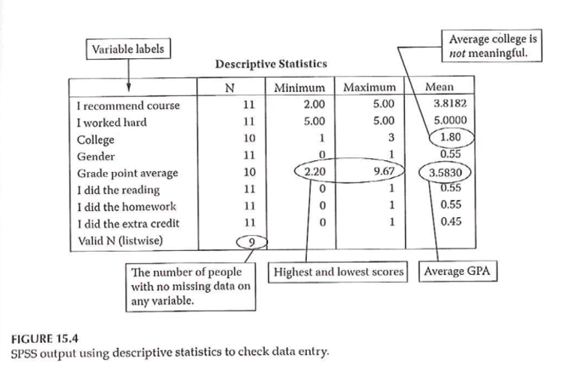
Data Collection & Coding

Slide 33
Assignment #8
Further refine your list of variables by specifying how each will be measured. Wherever appropriate, include the name of a specific measure. Do this by building onto the methods section of your research proposal draft.

Slide 34
Assignment
Further refine your list of variables by specifying how each will be measured. Wherever possible, include the name of a specific measure that would be appropriate. Be as specific as you can in terms of what variables/measures will be obtained. This assignment should give you a final draft of the “measures” description included in the Methods section of your research proposal. What you submit for this assignment should reflect the feedback you received on the last assignment.
Prepare for next weekâ€™s session

Slide 35
Discussion questions
Discuss the data collection method that is appropriate for your research proposal.
Discuss the procedure you would propose to collect data for your research proposal.

Slide 36
Additional slides

